Slide 1
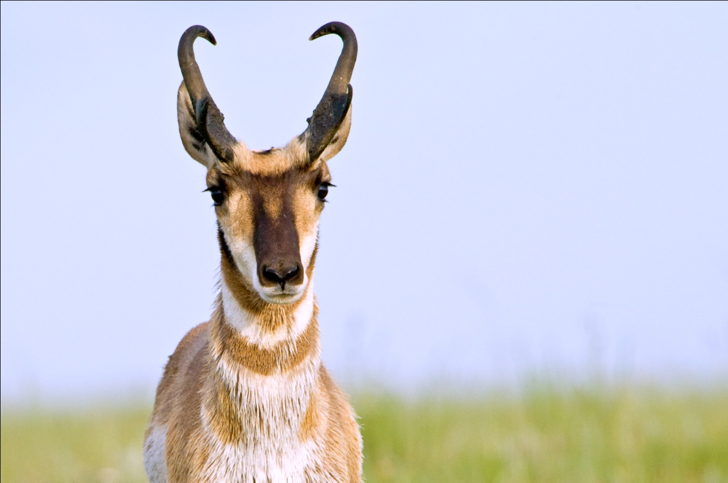
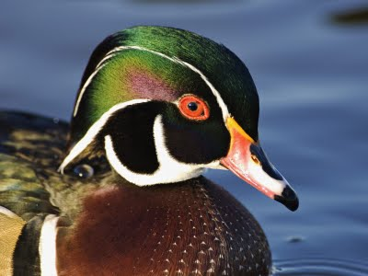







Ecosystems in Transition: Decision Support Tools to Measure, Monitor and Forecast Climate Impacts on Migratory Species
Bob Crabtree, YERC/Univ. Montana
Scott Boomer, USFWS
Rex Johnson, USFWS
Kathy Fleming, USFWS
Emily Silverman, USFWS
Christopher Potter, NASA
John Kimball, Univ. Montana
Jennifer Sheldon, YERC
Daniel Weiss, YERC
… many other NGOs, Universities, and State Fish & Game Dept.’s
Notes:
Thanks Woody. I want to start by thanking the many US Fish and Wildlife Service biologists, especially the co-Is at the folks at Patuxent Wildlife Research Center and the HAPET joint venture in PPR. Also DU Canada and the NA Waterfowl Working Group.

Slide 2
Combine Two NASA Projects
DECISIONS: Development of Risk-Reward Spatial Capacity Models for use with the USFWS Strategic Habitat Conservation Framework (SHC) LCCs
A.30 BioClim: Ecosystems in Transition: Decision Support Tools to Measure, Monitor and Forecast Climate Impacts on Migratory Species
Notes:
Now Woody asked me to address two awards that overlap by one year—and we are currently in that overlap year.
Essentially, the techniques and models developed in the first project HERE (development of spatially-explicit population models for the new DOI Landscape Conservation Cooperative program) are being enhanced and applied (HIT SLIDE CHANGE) …

Slide 3
Combined overarching goal
“Quantifying environmental impacts—all factors?—on species populations to build towards spatiotemporal forecasting models for involved decision-makers”
Combine Two NASA Projects
DECISIONS: Development of Risk-Reward Spatial Capacity Models for use with the USFWS Strategic Habitat Conservation Framework (SHC) LCCs
A.30 BioClim: Ecosystems in Transition: Decision Support Tools to Measure, Monitor and Forecast Climate Impacts on Migratory Species
Notes:
… the second award, a challenging application with migratory waterfowl at the continental scale.
And in order to involve decision-makers, in the combined goals of both projects, the first project focused on two MAJOR deficiencies.

Slide 4
Background
Applications goal(s):
Provide needed tools for ecosystem assessments and to quantify environmental impacts (e.g., climate and management actions)
Increase access to those environmental datasets needed (e.g., NASA data) to understand cause and consequence
Science question(s): — hypotheses same as Volker’s mistiming strategies
Can we predict [migratory] species movements in response to climate disruptions and other related disturbance impacts?
What are the past, present, and future demographic consequences of these combined impacts and movements?
Notes:
Thus, our intent was to merge the applications and science goals with MODELING… since they really should go hand-in-hand

Slide 5
Background
Applications goal(s):
Provide needed tools for ecosystem assessments and to quantify environmental impacts (e.g., climate and management actions)
Increase access to those environmental datasets needed (e.g., NASA data) to understand cause and consequence . . .
Science question(s): — hypotheses same as Volker’s mistiming strategies
Can we predict [migratory] species movements in response to climate disruptions and other related disturbance impacts?
What are the past, present, and future demographic consequences of these combined impacts and movements?
MODELING
. . . pretty MODELS
Notes:
Thus, our intent was to merge the applications and science goals with MODELING… since they really should go hand-in-hand

Slide 6
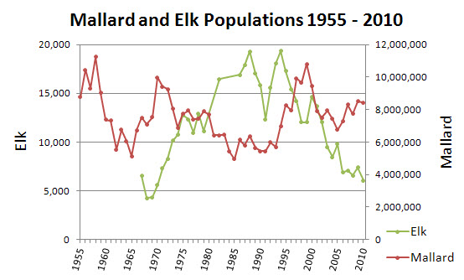
Legacy Data: continuous quasi-experiments
Notes:
In fact, another way of looking at both projects is: Making the most of out of agencies’ long-term ‘legacy’ data sets to inform management decisions that recover and sustain species populations.

Slide 7
Legacy Data: continuous quasi-experiments
Models: a common language for scientists and practitioners
Y_{ij} = X1_{ij} + X2_{ij} + X3_{ij} + X4_{ij} ....
Response or dependent variable
Explanatory variables… COVARIATES
Notes:
The common language for both practitioners (managers, biologists, conservationists) and scientists: Answer: Models from narrative to quantitative. We need explanations and hypotheses to test, which comes in the form of the explanatory variables or COVARIATES for short—these large data sets on factors like…
Build diagnostic then predictive models for ECOLOGICAL FORECASTING. How can we first “mine” these species data sets and assign signal to appropriate causal explanatory variables or ‘covariates’, such as: CHANGE SLIDE:
…. For both scientists, practitioners, decision-makers. This generalized modeling approach is the basis for rational, evidence-based decision-making and the ultimate goal and challenge of EAGLES.

Slide 8
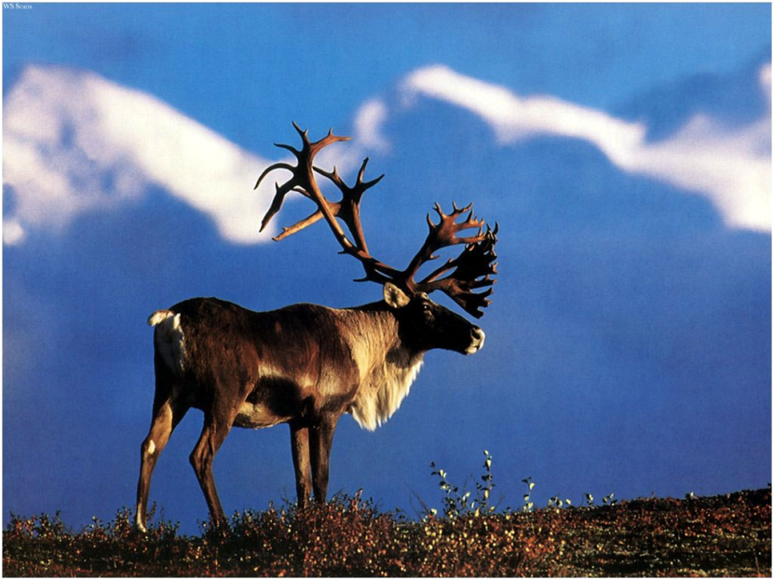
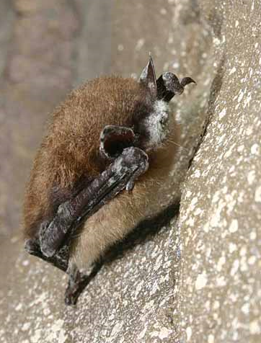
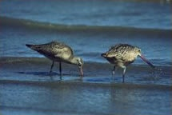
Focal Species (Legacy) Data Sets Analyzed
Bison – migration and habitat
Lesser Scaup – demography w/ climate/water
Indiana Bat – demography w/ climate change
Coyote – habitat and demography
Small Mammals (5 species) – habitat
Red Fox – winter habitat w/ snow dynamics
Elk – habitat with path & memory functions
Sage Grouse – habitat and demography
Pronghorn – demography, recruitment
Pronghorn habitat (2); WY and ID – habitat w/ scenarios
Caribou – habitat and path movements
Evening Primrose – habitat w/ climate scenarios
Swift Fox – habitat with variable availability
Grasshopper Sparrow – habitat
Moose – habitat and path movements
Notes:
So, in the first project we merged agency legacy data sets (listed here… spanning 3 to 35 years) WITH a variety of explanatory covariates, many of them NASA data to create models capable of valid inference when used for forecasting. Those in blue are in various stages of publication, those in bold I will give a brief example of the results.

Slide 9
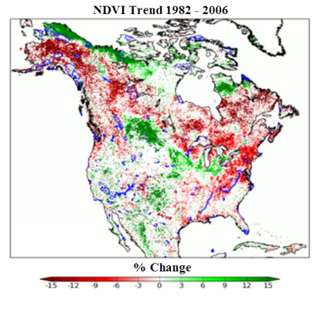
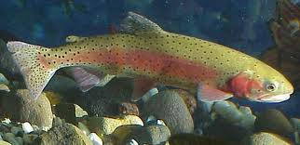
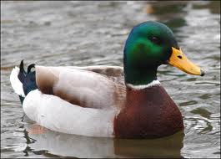
Integrated Project Objectives
1. Measure, monitor, and analyze the conditions of ecosystems for conservation decision-making and predictive modeling capabilities using existing, enhanced, and new NASA data, data products, and NASA-data model output (Ecosystem Assessment).
2. Implement diagnostic analyses and predictive modeling of (a) habitat movements (distribution), and (b) population vital rates for understanding the effects of climate and climate-related environmental impacts on species populations (Geospatial Analysis).
3. Enhance user-friendly, computer-based (web and PC) decision-support tools to create species forecasts under habitat and climate projection scenarios, all in a ArcGIS environment (Landscape Evaluation).
Notes:
So a brief review of our integrated science and applications objectives as applied to both projects.
Conduct ecosystem assessment with the covariate layers and to use those assessments to develop apriori models—which candidate covariates to include in the diagnostic models in number (2), and then finally prognostic models for decision-making in number 3 for management What-if-Scenarios and future climate projections.

Slide 10
Integrated Project Objectives
1. Measure, monitor, and analyze the conditions of ecosystems for conservation decision-making and predictive modeling capabilities using existing, enhanced, and new NASA data, data products, and NASA-data model output (Ecosystem Assessment).
2. Implement diagnostic analyses and predictive modeling of (a) habitat movements (distribution), and (b) population vital rates for understanding the effects of climate and climate-related environmental impacts on species populations (Geospatial Analysis).
3. Enhance user-friendly, computer-based (web and PC) decision-support tools to create species forecasts under habitat and climate projection scenarios, all in a ArcGIS environment (Landscape Evaluation).
EA.G.LE.S Tools: an engine (process) in need of fuel that might get us to forecasting if we’re lucky
Notes:
This three part system is just that a workflow that can be applied to any species dataset. And the acronym here that captures this process, we call EALGES. It’s an ENGINE in need of FUEL and that fuel is NASA data and data products.

Slide 11
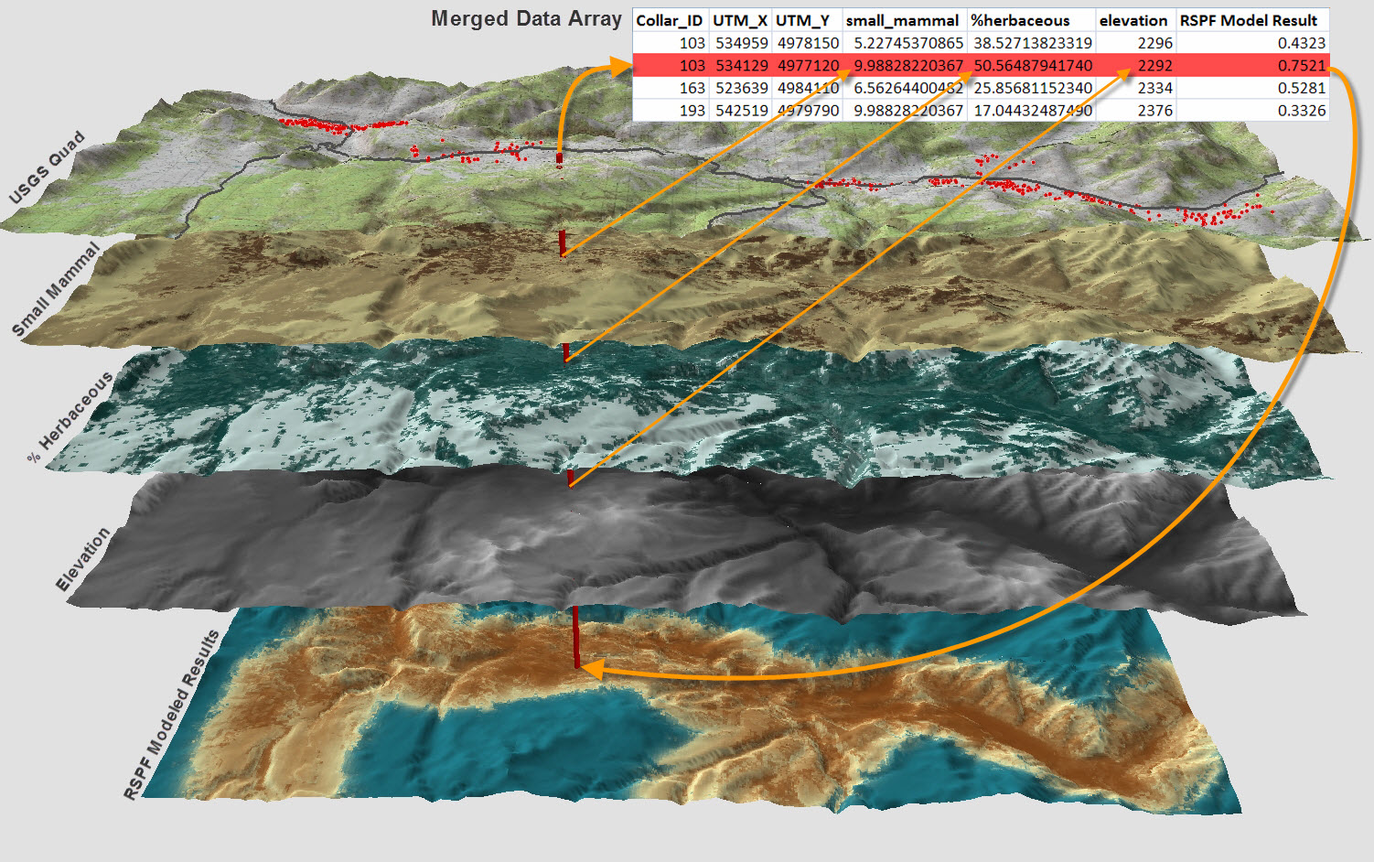
Visual MDA and Model Output
Example: Resource Selection Analysis (RSF tool)
Merged Data Array
1
2
3
4
Model prediction
Single point ‘drilling down through’ data layers is basis for all modeling approaches
Notes:
Here is a visualization of about 80% of the work flow process—merging species observations (red dots) with NASA covariates layers (explanatory variables). As many of you know, is tedious, complex, manifold, and in too many cases more of an art than a science. So rather than a whole lot of ONE-OFFS, we decided to engage our federal agency assessment team, listen to their specific needs—careful not to impose our own constraints—and then carefully develop the TOOLS to standardize the workflow and make it transparent and rigorous so that land management agencies can do the analysis themselves. --No small task—

Slide 12
Overview of Species Decisions Tools
(called EAGLES: Ecosystem Assessment, Geospatial Analysis, and Landscape Evaluation System)
EAGLES Tools
Management Decision-Question
Geospatial Data WIKI
Interpretation & Decision Making
COASTER (web & ArcGIS)
Covariate Data Integration
Exploratory Data Analysis
Species Popn. models
What-if-Scenarios (EF)
free use/download at www.yellowstoneresearch.org
Notes:
Here are some of the toolkit groups we developed to get us through the workflow from the management question to data discovery to data merging to analysis to modeling and to forecasting leading to decision-making… that collectively called EAGLES . They are all free if you have: ArcGIS and access to the internet—and fairly user-friendly. You can find them at our website here…
Now, I will use the COASTER tool as an example and show some model results. And BTW, we use the term RISK population models to emphasize the inclusion of all known factors—risks and rewards—in statistical models that are both spatially-explicit and temporally dynamic.

Slide 13
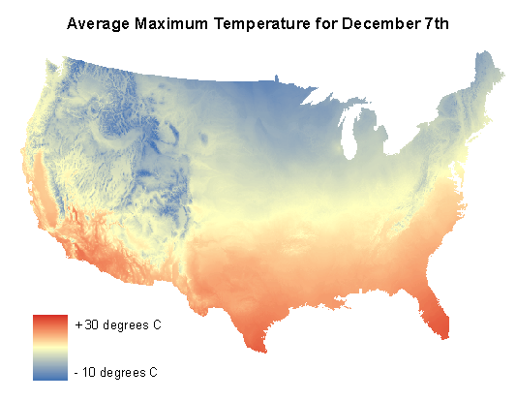
COASTER for temporally-dynamic raster datasets
e.g., daily climate data at 1km from 1950-2009 (lower 48)
see www.coasterdata.net
Notes:
READ the ACRONYM. Is a tool for easy access and manipulation of large data sets (many Terrabytes) for trends, anomalies, theshholding, and analysis for any raster datasets. Here we displayed pulling out a single day of an extreme weather event within a 60 year data set of daily climate data. There are many other functions and capabilities with the COASTER toolset. Say here what COASTER is and how it allows you to manipulate many large spatial data sets through time and how to cookie-cut what you want.

Slide 14
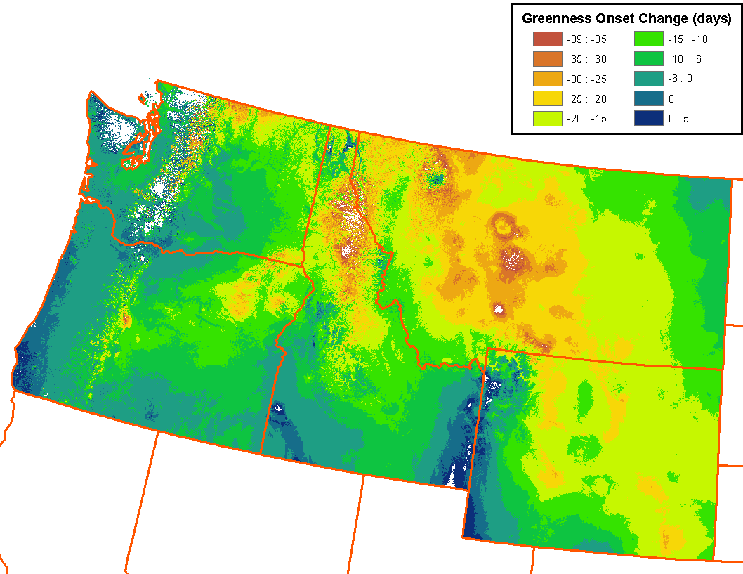
Example Analysis Enabled by COASTER: Assessing Changing Greenness Onset Date
Regions with increased moisture stress: - Central Montana
  - Higher elevation sites
  - Sites with low precipitation
Weiss and Crabtree, submitted
Notes:
COASTER can also be used to conduct Ecosystem Assessments, for example here, where we looked at a 55-year trend in spring green-up in the PNW and Northern Rockies.

Slide 15
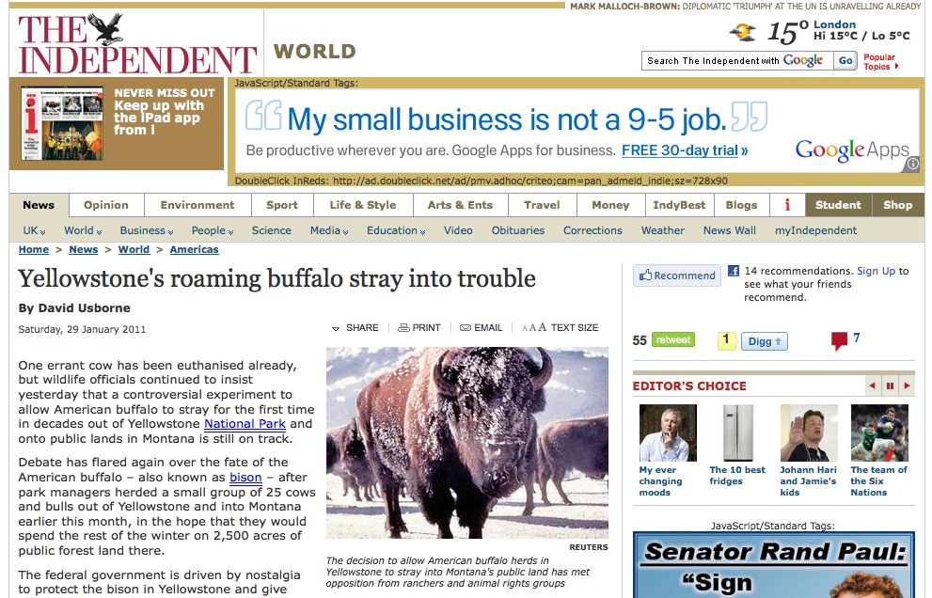
Example 1: Getting started with migratory species: Yellowstone Bison
What are the determinants (predictors) of when bison leave the park during winter?
And can we use them to predict movements to engage in management actions?
Notes:
An example of this whole process and how we got started with migratory species is our work with BISON work in Jellystone—a rather nasty migrator in many ways. They gave us a call about 5 years ago in need some serious decision support for habitat planning, ID-ing corridors, herding on horses, media response teams, corralling, injecting, capturing, dealing with contenious partners to name few.

Slide 16
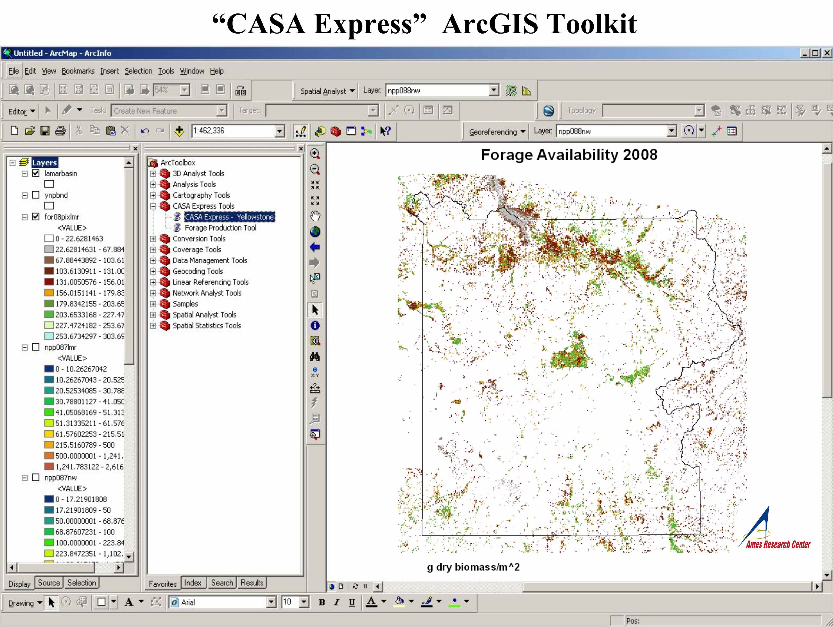
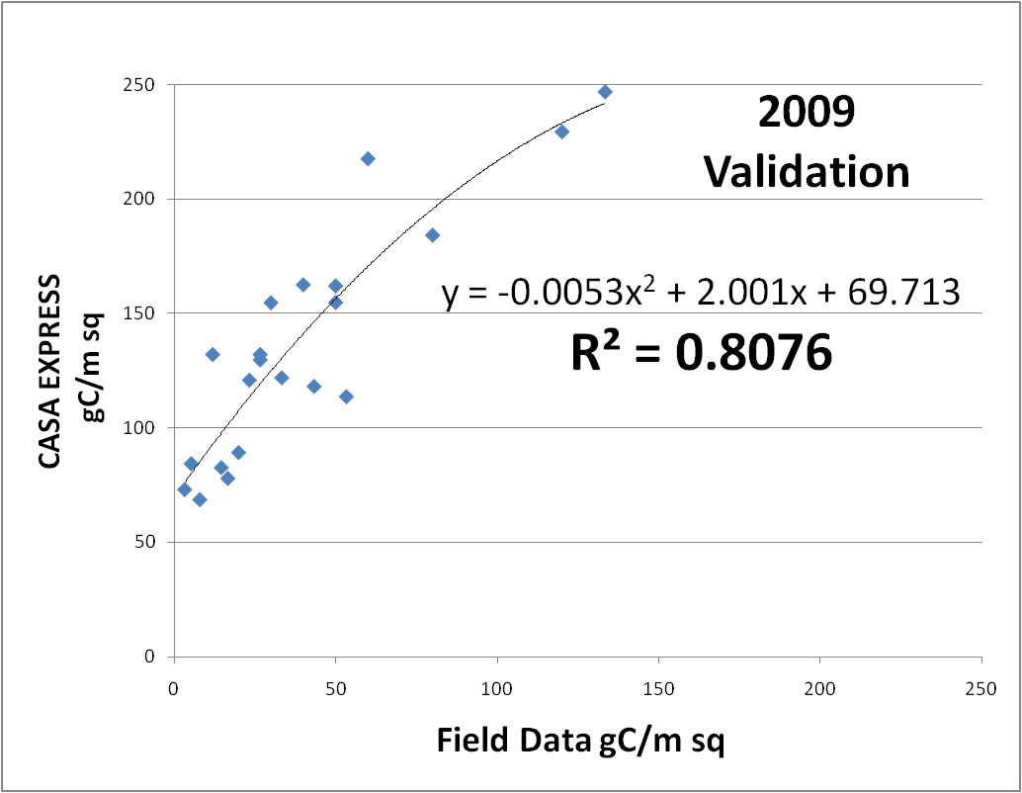
2008 Validation
Notes:
Developed yet another ArcGIS plug-in. This one calculates aboveground forage biomass.

Slide 17
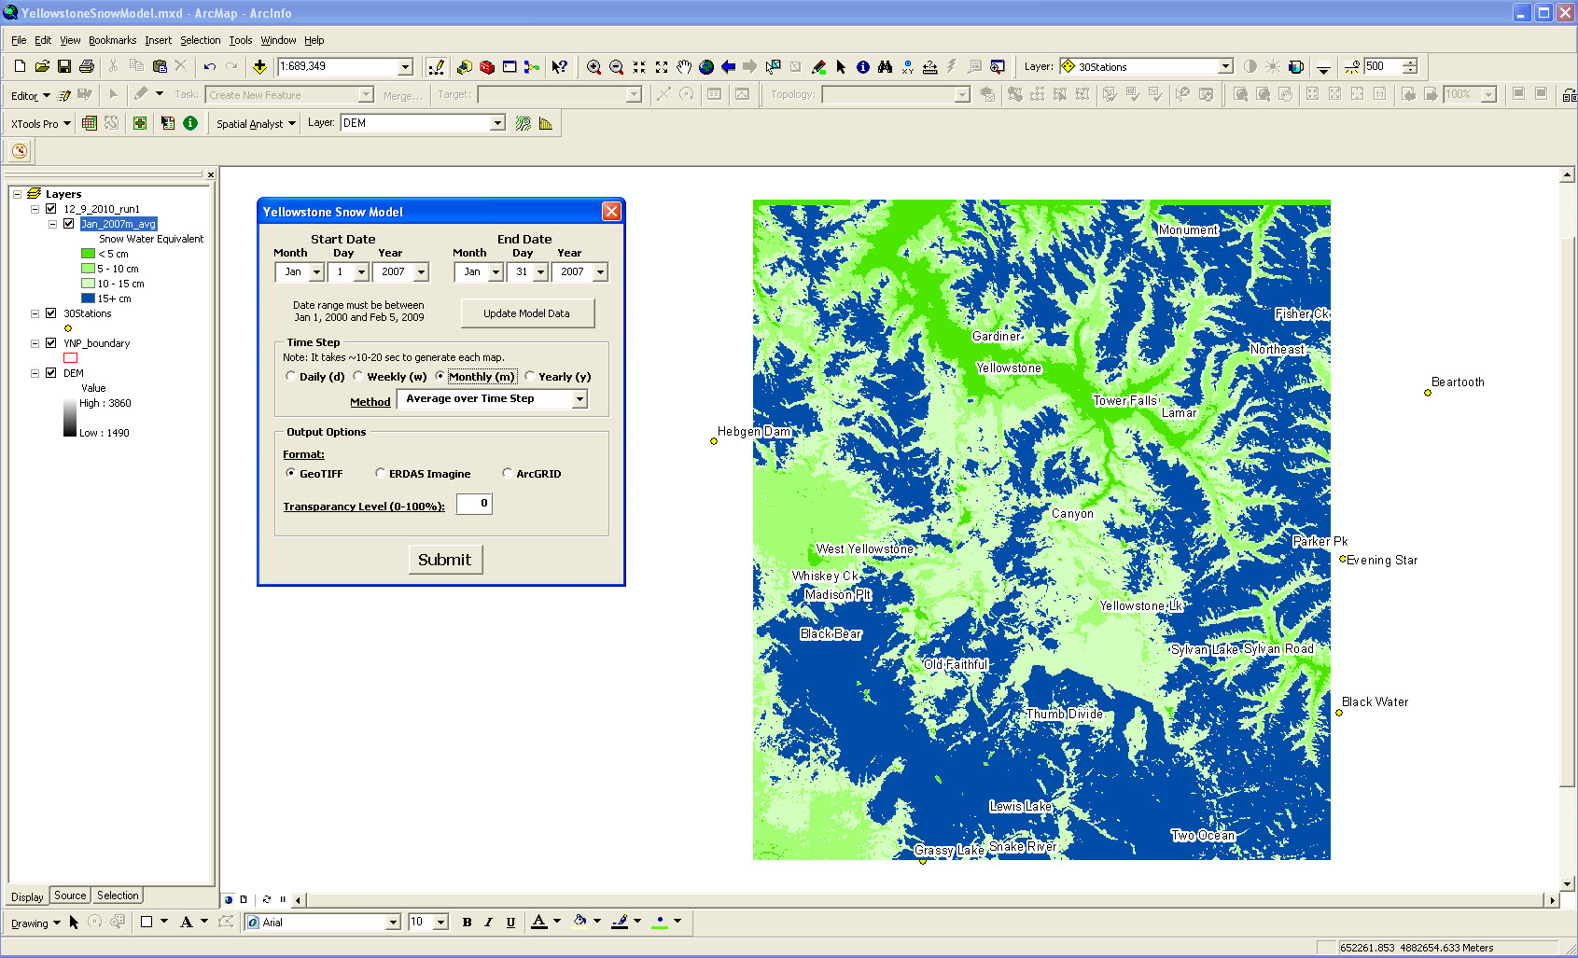
Geremia, C., P. J. White, R L. Wallen, F. G. R. Watson, J. J. Treanor, J. Borkowski, C. S. Potter, and R. L. Crabtree. 2011. Predicting Bison Migration out of Yellowstone National Park using Bayesian Models. PLoS ONE 6(2): e16848.doi:10.1371
Notes:
This ArcGIS plug-in automatically goes out and grabs and ingests daily snotel data into a multiple regression model and to create daily or monthly snow-water-equivalent surfaces to later modeling in this case…. Bison responding to changing snowpack. The three significant variables for predicting movements: herd size, annual forage biomass, and changing snowpack. Where would the model be without forage biomass and snowpack…. Deficient?

Slide 18
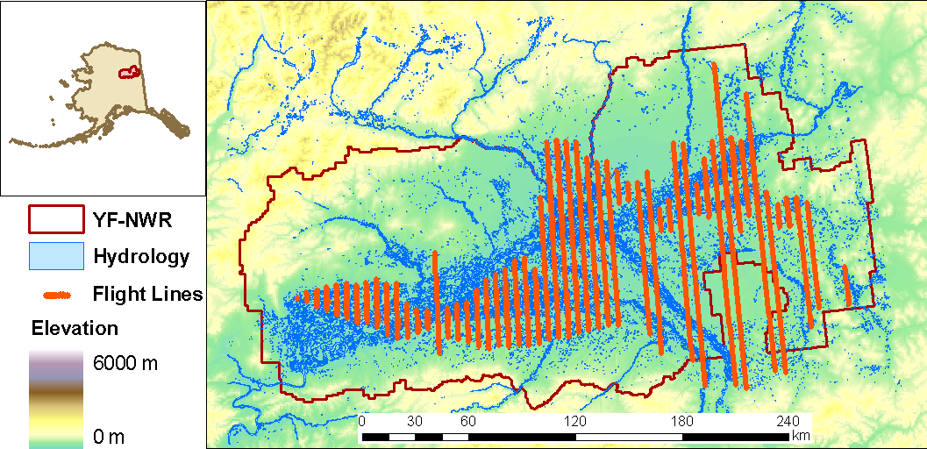
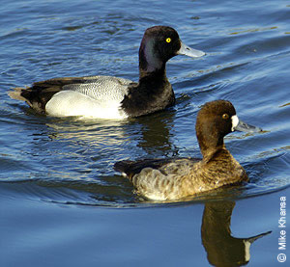
Example 2: Lesser Scaup Response to Climate
Aerial observations from 2001 to 2009
First built a traditional habitat model using static covariates:
  - Preferred emergent wetlands and bigger, more round ponds
  - Preferred still water over turbid water; avoid wooded wetlands
Model | AIC score
GLM (negative binomial) | 21703
GLMM (negative binomial) | 21708
GLM (negative binomial) including Min. Temp. Anomaly | 21697 ** Best Model
* Then added minimum temperature anomaly
Notes:
We got our feet wet with waterfowl data by analysis of a 9 year data set from Yukon Flats NWR in Alaska to examine why lesser scaup have been declining. Major challenge in dealing with both spatial and temporal variability.

Slide 19
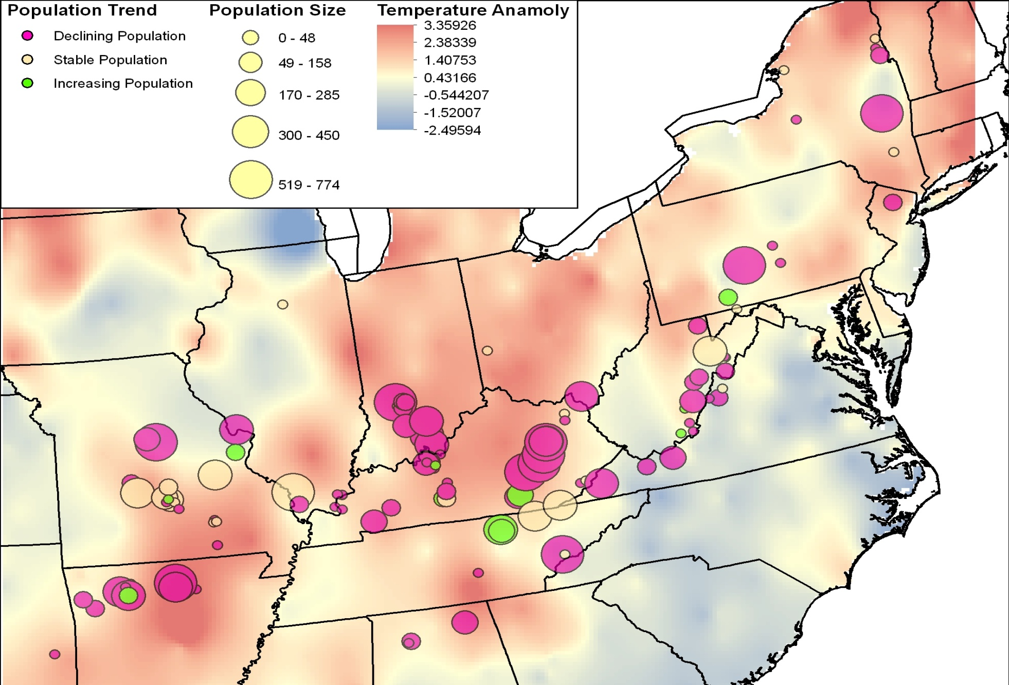
Example 3: 30-year spatio-temporal I-Bat analysis
30-yr anomaly trend against year 2000 via COASTER

Slide 20
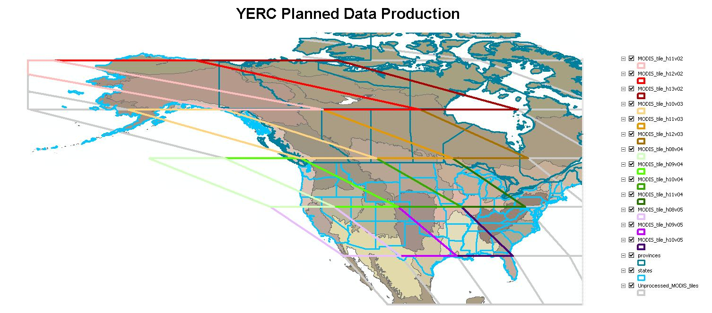
A.30 BioClim: Mid-Continent Study Region
combined Central and Mississippi flyways
RESPONSE: 1955 to 2011 aerial survey of waterfowl breeding pair density, brood production, harvest and non-harvest mortality, and age ratios; possibly the best long-term demographic data set in the world. Higher spatial resolution starting in 2000.
Notes:
Back to our second project, our A.30 BioClim project… our study site is the mid-continent region. A continental scale study is a good match for new NASA data and data products, many of which we will be producing at a per MODIS tile basis using a variety of modeling approaches to get at a variety of temporally-dynamic covariates … We are in data production mode now for those needed covariates…

Slide 21
Temporally Dynamic Covariates (n=30)
Climate: TOPOMET (daily, 1 km, 1950-2009); t-min, t-max, precipitation, solar radiation, VPD
MODIS data products: existing + Percent Surface Water (PSW); fraction of H₂0 w/in 500m every 8 days
Freeze-thaw (AM, PM, and transition); NTSG datasets
Ecosystem modeled (CASA): NPP, litter biomass, ET/PET, soil moisture (4 levels), water stress, SWE, snowmelt
Annual Disturbance (PSI’s 1km global binary disturbance); forest/non-forest fire, agriculture, wetland gain/loss
Changing habitat conditions (NLCD w/ above disturbances?); not sure quite yet how we’ll produce annual updates
. . . providing direct, easy access to standardized datasets to avoid deficient and biased models for terrestrial species
Notes:
We have come up with a fairly standard set of temporally dynamic variables, many of which have been used in many of the species data sets we analyzed, and are producing them at various resolution across the continent. Those in red are what our agency partners are telling us to include at this point for waterfowl ... Mention that most of these will be posted very soon on COASTER for direct access and manipuation.

Slide 22
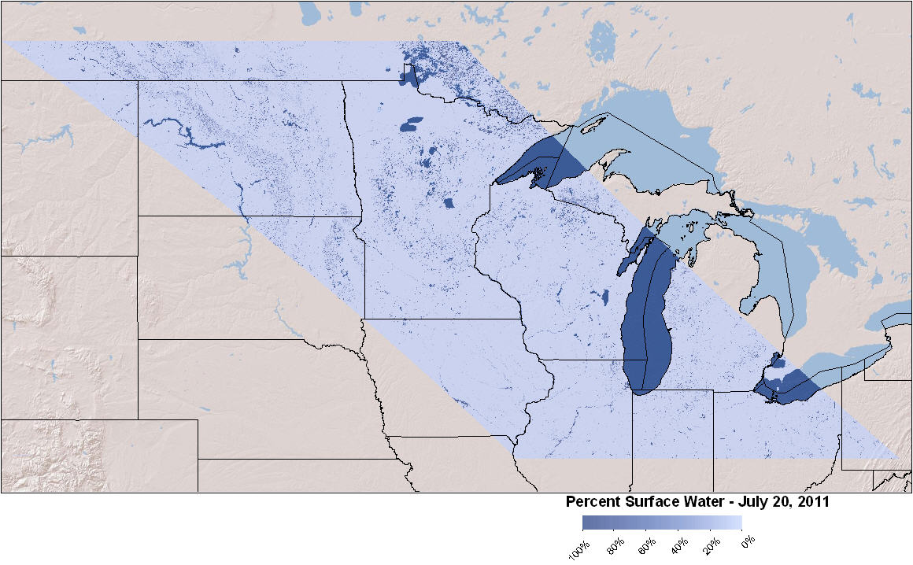
Percent Surface Water (PSW) Dynamics
Sub-pixel abundance of 500m pixels every 8 days (surface H₂0 phenology)
Weiss and Crabtree, Rem. Sens. Environ. (2011)
Notes:
Quick story on how we responded….

Slide 23
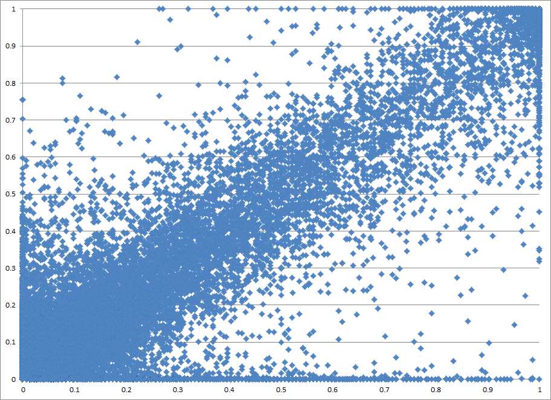
Measured vs. Modeled PSW
07/19/2005 (day 200)
Modeled
PSW
R² ranging from 0.65 to 0.85
Measured PSW
Notes:
Note that the points on the lower axis (Y of 0.0, measured < 0.3) were from errors in the Landsat classification (i.e., cloud shadow cells that were classified as water).

Slide 24
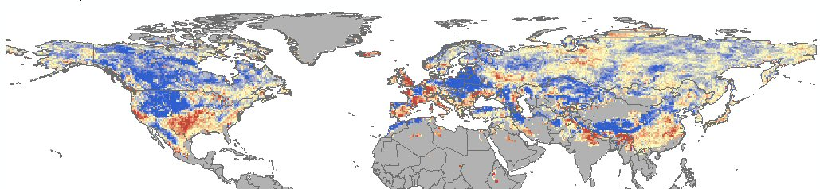

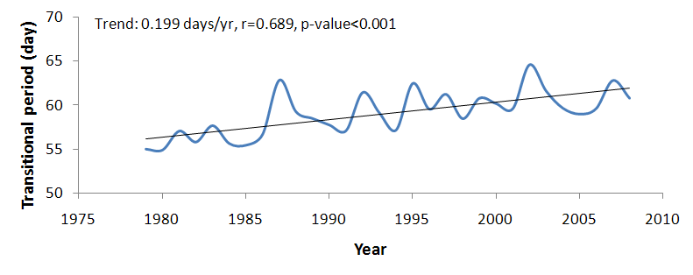
¹Transitional Period Trend (1979-2008)
Days yr⁻¹
Mean Northern Hemisphere trend
Mean Latitudinal Trends
¹Transitional days: AM frozen and PM non-frozen
Notes:
Variation in freeze/thaw during winter-spring transition has increased nearly one week over thirty years with a north-south reversal in the mid-continent region of NA. Trend for winter (Dec, Jan, Feb) transitional+thaw days is 0.169 days/yr (r=0.673, p<0.001). This has potential significance for reducing winter cold hardiness and increasing potential vulnerability to frost damage.

Slide 25
CASA_Wetlands v2 Production
  Produces modeled covariate output for:
    Net Primary Productivity, NPP (g/C/m^2)
    Litter biomass (g/C/m^2)
    Soil moisture at 4 depths
      - Inundated soils, soil organic layer, top mineral soil, mineral subsoil
    Evapotranspiration and potential evapotranspiration.
    Snowfall, snow pack and snow melt.
    Drainage
      - Water draining from soil once field capacity is reached
    Soil nitrogen forms
      - Nitric oxide (NO), Nitrous Oxide (N₂O), and Nitrate (NO₃)
    Water stress term – where PET exceed precipitation

Slide 26
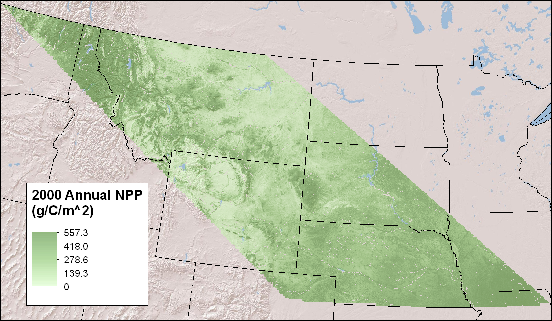
CASA_Wetlands v2 Results & Validation

Slide 27
General EAGLES Workflow Architecture for species population decision-making
Species legacy
datasets (response)
Modeling Options
Ecosystem Assessments
Focal Species (RRSC)
Future Forecasts
Adaptation Strategies:
Landscape and
Management Plans
NASA and RS Geospatial Data (explanatory)
EAGLES Tools & Work Flow
?
Potential Outcomes — ‘beyond the honest broker’:
Modification of the aerial survey methodologies
Constraining the Adaptive Harvest Model (bag limits)
Prioritize existing wetland management activities
Notes:
… remember our deliverables to the Service are geospatial data and analysis tools that move these data through the workflow architecture within an ArcGIS environment (that’s EAGLES in a nutshell).
-- Now we are going to go from 10,000 feet here and down to about 1,000 (get into some of the more detailed concepts) to show you how our TOOLS get you, the decision-makers to the end point that addresses our challenge here (point to the challenge question).

